Slide 1


Slide 2
This project analyses the 2024-2025 NBA Player Stats to uncover insights into individual performance trends throughout the season.
Key Objectives:
Identify the best all-around players in the NBA.
Balance offensive and defensive metrics to ensure fair evaluation.
Explore key efficiency metrics and correlations to gain deeper insights.
Why is This Important?
Helps teams evaluate potential new talent objectively
Demonstrates how data analysis impacts sports decision-making
Dataset Sources: Source - https://www.nbastuffer.com/2024-2025-nba-player-stats/
Data Collection Method - CSV file All data correct as of 05/03/2025

Slide 3
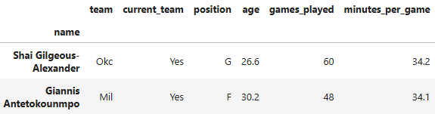
Data cleaning and processing
Before conducting any analysis, the dataset underwent a thorough cleaning process to ensure accuracy and consistency.
This involved: Handling Missing & Inconsistent Data, Standardising Formats and Ensuring Data Integrity

Slide 4
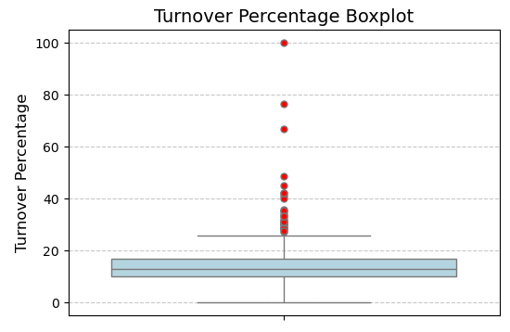
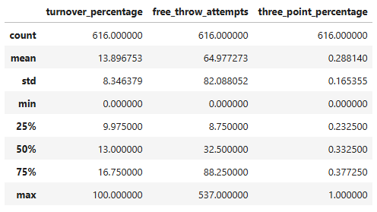
Exploratory Data Analysis – Turnover %
Someone has a 100% turnover rate – meaning they turn the ball over every time they try to score.

Slide 5
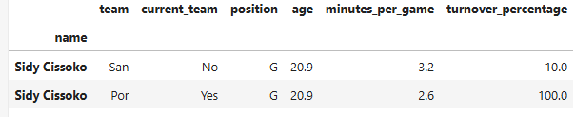
Exploratory Data Analysis – Turnover %
This suggests Sidy Cissoko has lost the ball on every single possession since he was traded to Portland, which is likely why he has only played 6 minutes in the league this season.

Slide 6
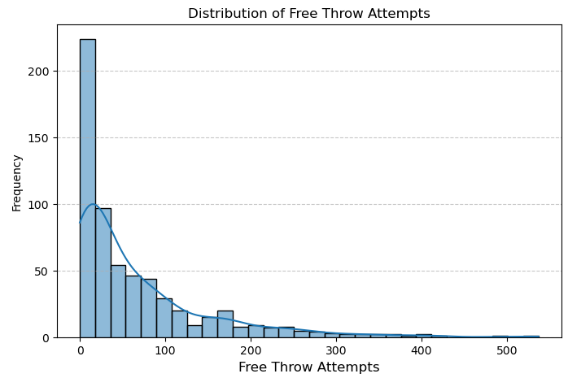
Exploratory Data Analysis – Free Throw Attempts
Most players take very few free throw attempts, with a long tail extending toward higher values and potentially superstar players who draw a lot of fouls.
A few players attempt over 200-500 free throws, indicating elite scorers who draw a lot of fouls.
One player has attempted over 530.

Slide 7

Exploratory Data Analysis – Free Throw Attempts
After investigating, Shai is having an incredible season, and 9 free throws per game isn't a ludicrous average at all.

Slide 8
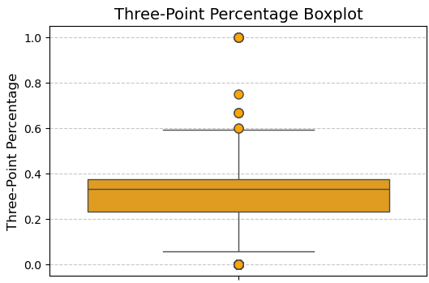
Exploratory Data Analysis – Three-Point %
Most players fall within a three-point shooting range (20-45%).
Outliers at 100% accuracy could indicate players who took very few attempts but made all their shots.
Low outliers near 0% might suggest players who are poor shooters but still attempt threes.

Slide 9
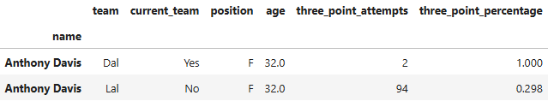
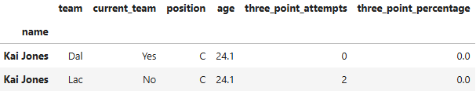
Exploratory Data Analysis – Three Point %
Due to the small sample of 2 attempts, it is possible that Anthony Davis made both.
Kai Jones is a C (Centre), and they are certainly not notorious for their three-point shooting. He has missed both of his attempts before getting traded.

Slide 10

Offensive Players
Identify the most impactful offensive attributes – which stats correlate strongly with overall scoring and efficiency?
Discover my weighted efficiency formula – giving more weight to key factors that have the greatest influence on an offensive player.

Slide 11
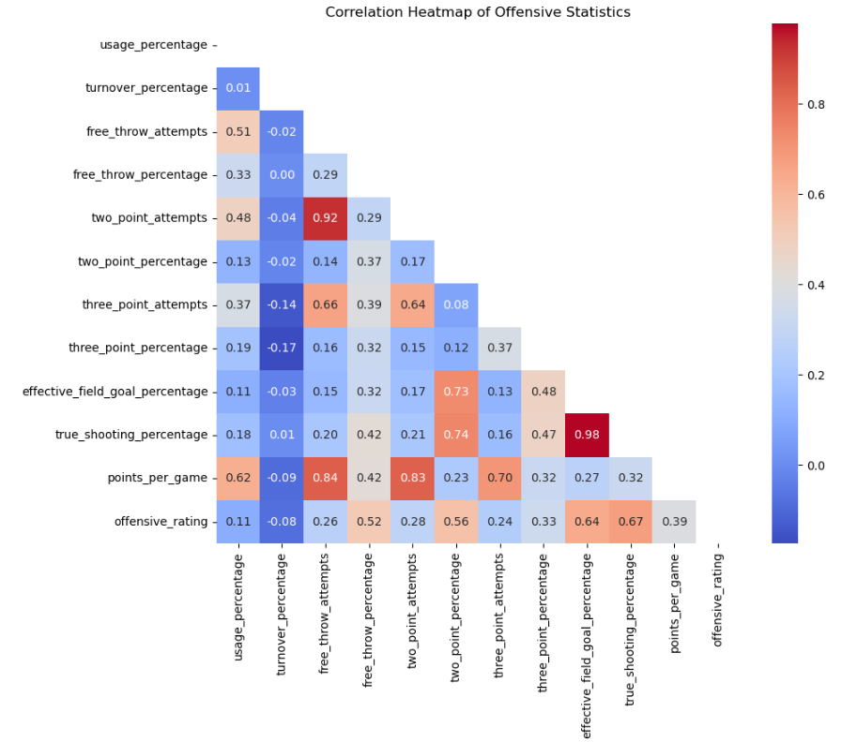
Offensive Players
Relationships between different offensive basketball statistics
Values closer to 1 indicating a strong positive correlation
Closer to -1 showing a negative correlation.
E.g. True Shooting Percentage and Effective Field Goal Percentage are highly correlated (0.98)

Slide 12
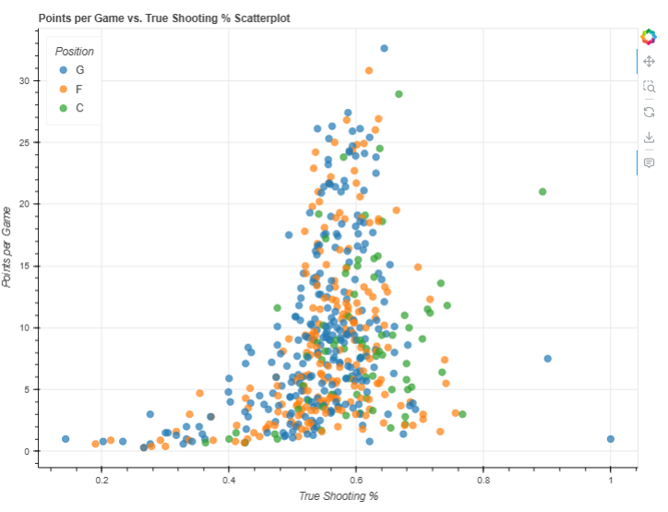


Offensive Players
Higher Efficiency, Higher Scoring – Players with a higher True Shooting % (TS%) generally score more points per game, confirming that efficient shooters tend to be high-volume scorers.
Positional Trends – Guards and Forwards score the most points, while Centres are more efficient but score less due to their close-range shots.
Elite Scorers Stand Out – Players like Shai and Giannis exceed 30+ PPG, showcasing top-tier efficiency and scoring ability.

Slide 13
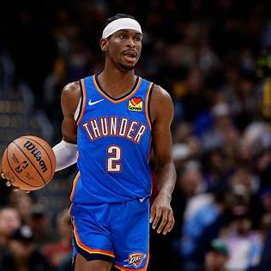
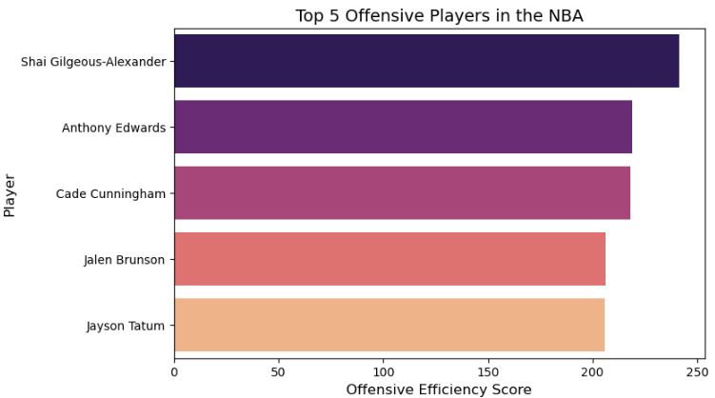
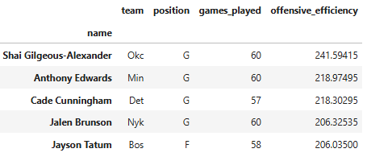
Shai Gilgeous-Alexander (OKC)
True Shooting%: 0.644 (Best in the group)
Usage: 34.5% (Highest)
Efficiency Score: 241.59 (Well ahead of others)
SGA is both highly efficient and heavily relied upon.

Slide 14
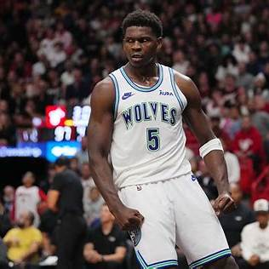

Anthony Edwards (MIN) & Cade Cunningham (DET)
Usage: Edwards 31.7%, Cunningham 32.6%
Scoring Styles: Cunningham 814 two-point attempts, Edwards - 607 three-point attempts
Efficiency Scores: Edwards 218.97, Cunningham 218.30
Both dominate possessions but with different shot distributions.

Slide 15
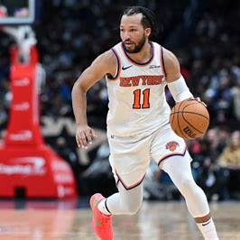
Jalen Brunson (NYK)
True Shooting%: 0.606 (2nd best)
Usage: 29.5% (Lower than others)
Efficiency Score: 206.33
Highly selective and efficient, making the most of his opportunities.

Slide 16

Jayson Tatum (BOS)
Two-Point Attempts: 582
Three-Point Attempts: 585
Usage: 30.9%
Efficiency Score: 206.03
A versatile offensive player contributing inside and outside the three-point line.

Slide 17
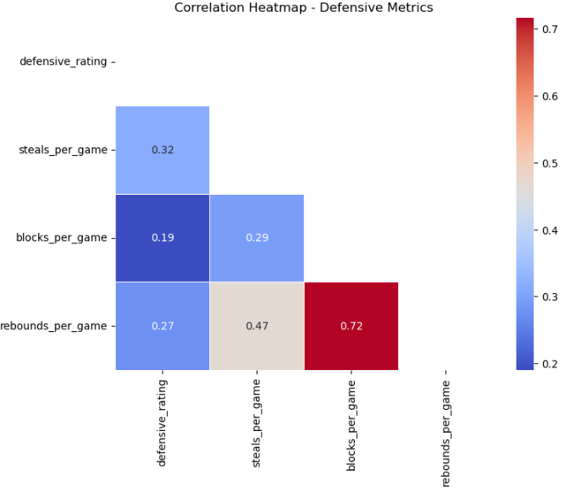
Defensive Players
Relationships between different defensive basketball statistics
Values closer to 1 indicate a strong positive correlation.
Values closer to -1 show a negative correlation.
Example: Rebounds per game and blocks per game have a strong correlation (0.72), meaning players who grab more rebounds also tend to record more blocks.

Slide 18
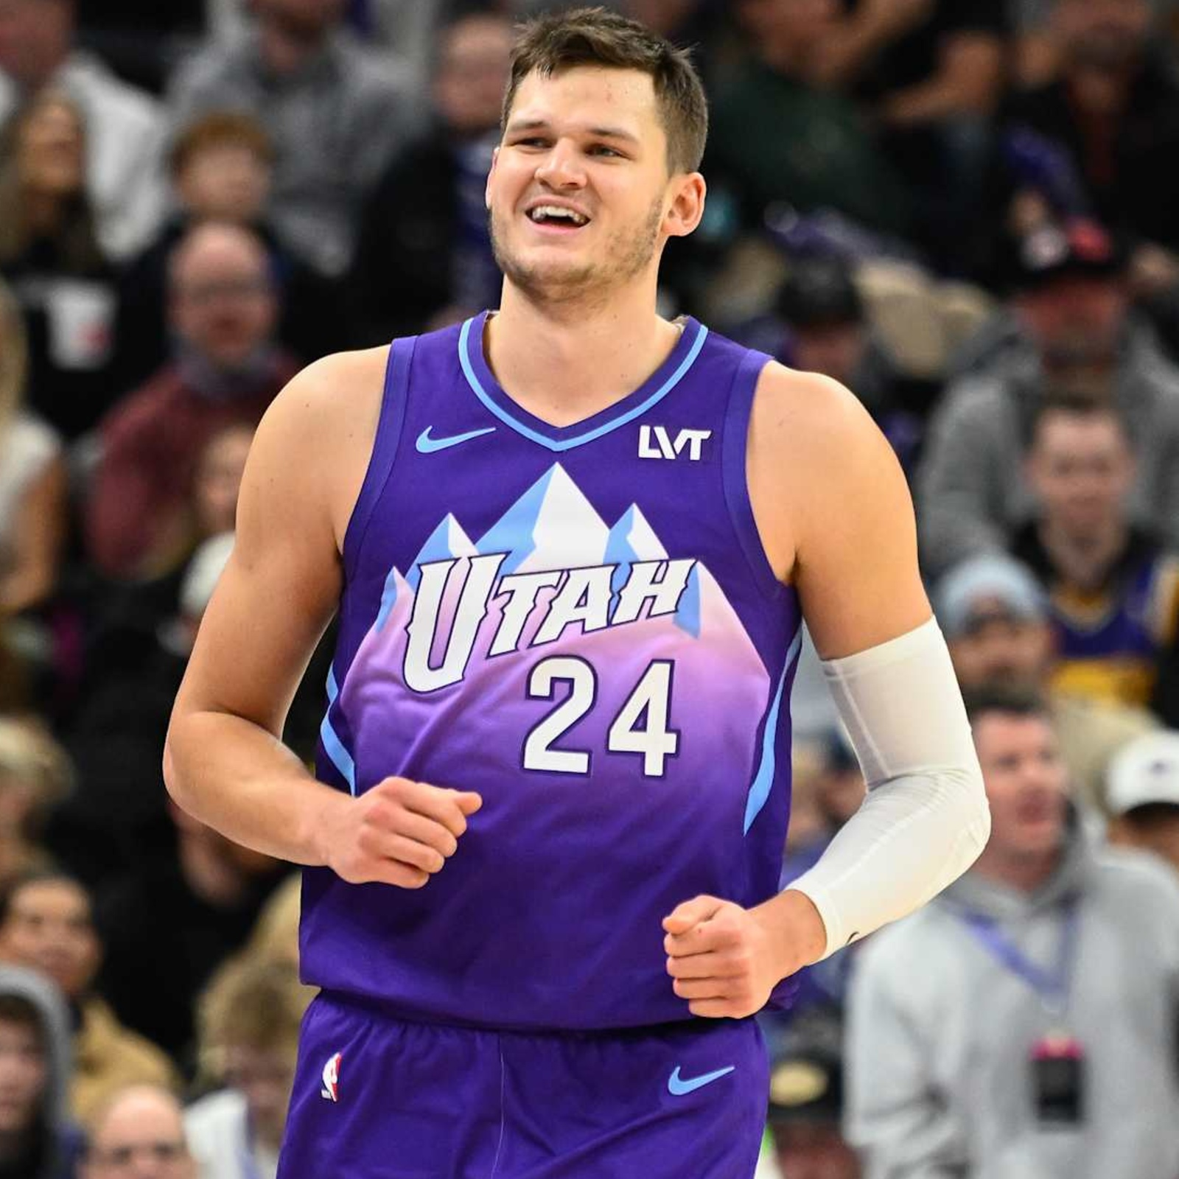
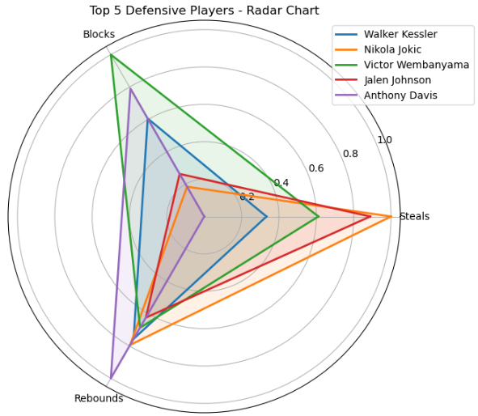
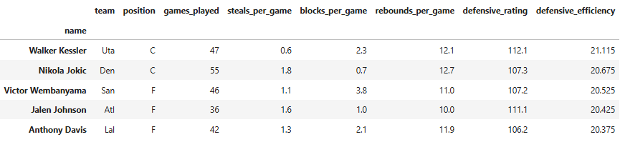
Walker Kessler (UTA)
Rebounding: 12.1 rebounds per game (2nd highest in top 5).
Shot Blocking: 2.3 blocks per game, strong rim protection.
Excelling in protecting the paint.

Slide 19
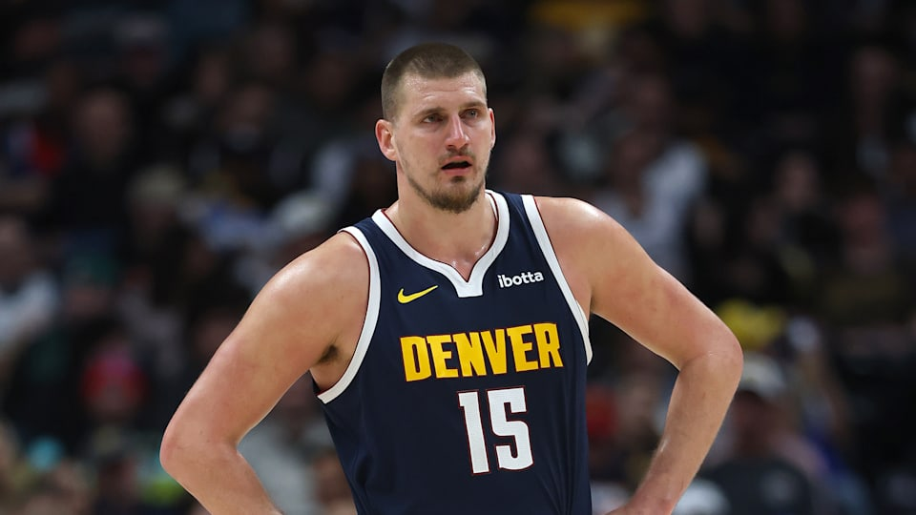
Nikola Jokic (DEN)
Steals & Blocks: 1.8 steals per game (highest in top 5) & 0.7 blocks per game.
Rebounding: 12.7 rebounds per game, making him an elite defensive rebounder.
Versatile defender with strong anticipation and rebounding impact.

Slide 20
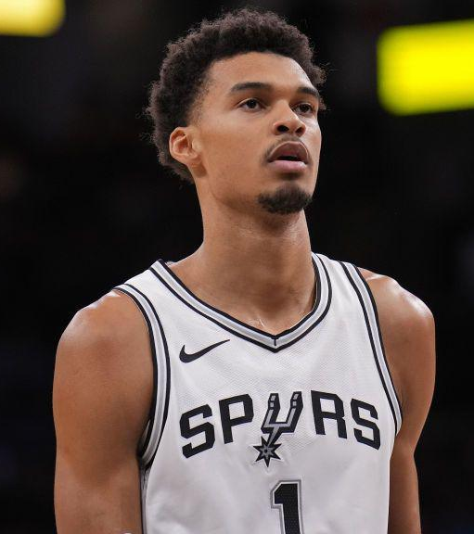
Victor Wembanyama (SAS)
Blocks: 3.8 blocks per game (by far the most in top 5).
Rebounding: 11.0 rebounds per game, controlling the boards.
The most dominant shot-blocker.

Slide 21
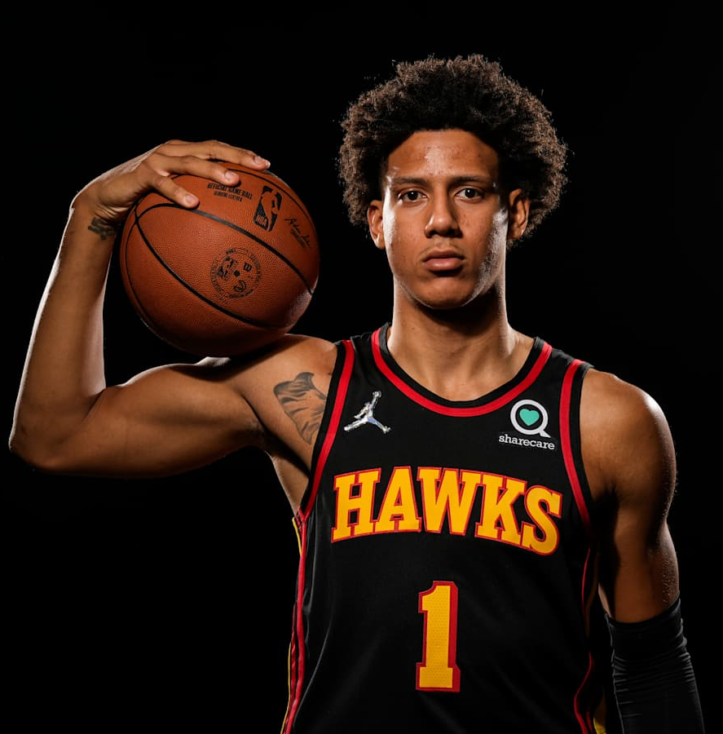
Jalen Johnson (ATL)
Steals: 1.6 steals per game (2nd highest in top 5).
Blocks & Rebounds: 1.0 blocks and 10.0 rebounds per game.
A well-rounded defender who disrupts passing lanes and controls the glass.

Slide 22
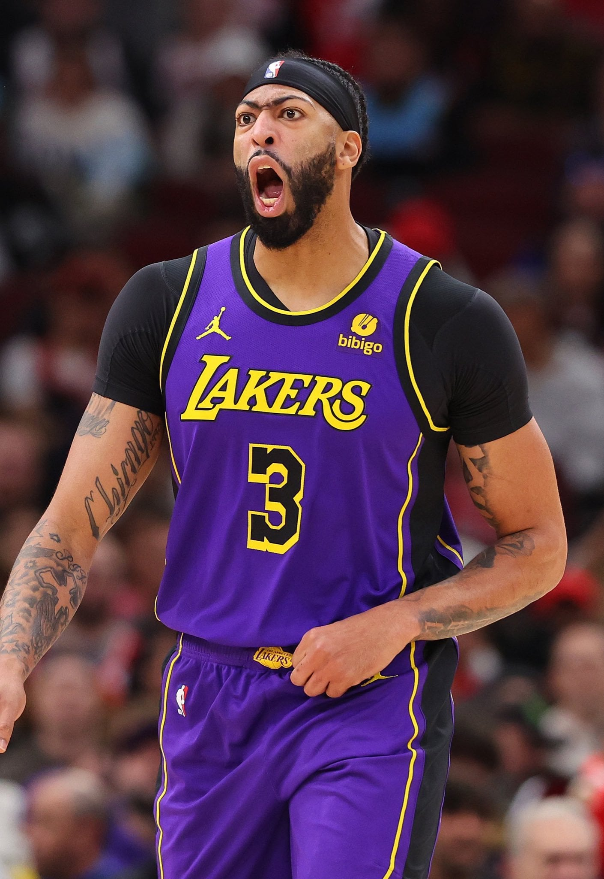
Anthony Davis (LAL)
Steals & Blocks: 1.3 steals and 2.1 blocks per game.
Rebounding: 11.9 rebounds per game, a key presence inside.
An elite two-way player known for his defensive versatility and rim protection.

Slide 23
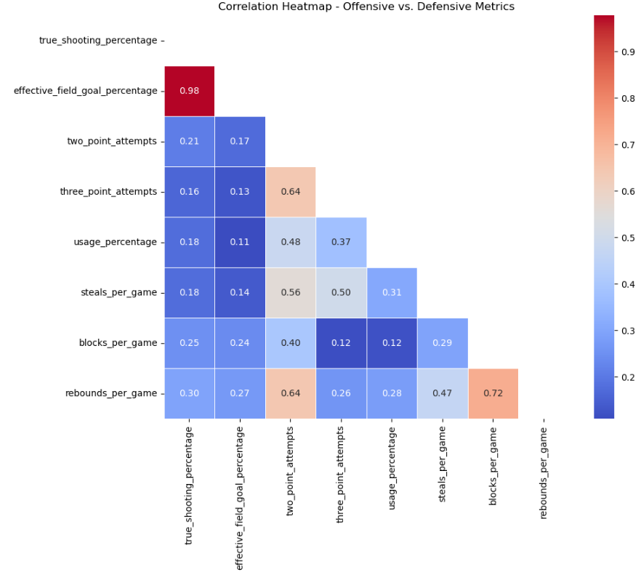
Finding the Best Players
Shooting Efficiency is Redundant: True Shooting % and Effective Field Goal % are almost the same (0.98 correlation), so using both in rankings isn’t necessary.
Offense and Defense Don’t Always Connect: Players who are great scorers don’t necessarily excel in defense, as offensive stats have little to no link with steals, blocks, or rebounds.
Balancing the Rankings: To fairly evaluate players, I needed to consider both offense and defense while avoiding duplicate stats to keep the rankings accurate.

Slide 24
Finding the Best Players
Final Metrics & Weightings
Offensive Contributions (50%)
True Shooting Percentage – 15% Usage Percentage – 10% Three-Point Attempts – 10% Two-Point Attempts – 10% Points Per Game – 5%
Defensive Contributions (50%)
Steals Per Game – 15%
Blocks Per Game – 15%
Rebounds Per Game – 10%
Defensive Rating – 10%
This ensures a balanced evaluation of both scoring ability and defensive impact.
Balanced Scoring & Defense: Offense and defense each contribute 50% to the final score to ensure a fair ranking.
Key Stats Matter More: Shooting accuracy, steals, and blocks have higher weightings (15%) because they strongly impact performance.
Avoiding Redundancy: Only the most important metrics are included to keep rankings meaningful and avoid duplication.

Slide 25
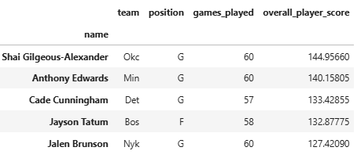
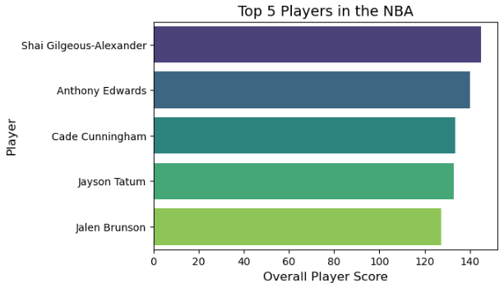
Finding the Best Players
I used a balanced scoring system to rank the top five all-around NBA players this season. Shai Gilgeous-Alexander leads the way.

Slide 26




The overall top 5 players are identical to the offensive top 5, reinforcing the idea that the NBA is an offense-driven league. A team's success is largely dictated by its ability to score efficiently, making offensive metrics a major factor in determining overall player impact.
While defense remains crucial, the data suggests that elite overall players are often those who excel offensively. This indicates that when teams look to acquire or build around a star player, offensive ability is the primary factor in decision-making.

